Slide 1
PROXY PATTERN
EMMANUEL CHISOYA

Slide 2
PROXY PATTERN
The Proxy Pattern is a structural design pattern that provides a surrogate or placeholder for another object to control access to it. It is used when we want to add a level of indirection to control access to an object, typically for purposes like lazy initialization, access control, logging, or monitoring.

Slide 3
STRUCTURE
Subject: This is the common interface or abstract class shared by the RealSubject and the Proxy. It defines the common operations for both.
RealSubject: This is the real object that the Proxy represents. It implements the Subject interface.
Proxy: This is the proxy class which acts as an intermediary between the client and the RealSubject. It typically controls access to the RealSubject, and may perform additional tasks before or after delegating the request.

Slide 4
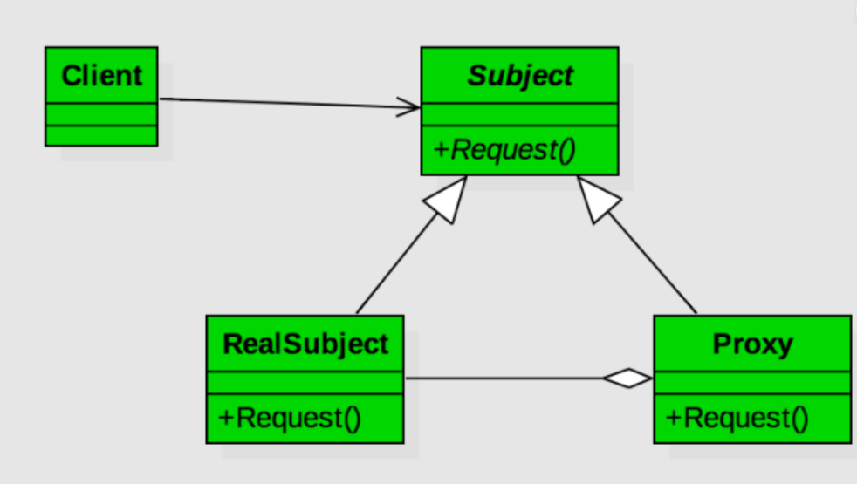
CLASS DIAGRAM

Slide 5
EXAMPLE
Virtual Private Network (VPN) Service
A Virtual Private Network (VPN) service is a good example of the Proxy Pattern in action.
Subject: The Subject here would be the internet connection that the user wants to access securely.
RealSubject: The RealSubject is the actual internet connection.
Proxy: The Proxy is the VPN service.

Slide 6
CODE IMPLEMENTAION
SMILE

Slide 7
CODE EXPLANATION
NetworkConnection Interface: This interface defines the common method connect(String website) that will be implemented by both the RealSubject and the Proxy.
ActualNetworkConnection Class: This is the actual network connection object that implements the NetworkConnection interface. It represents the real object that the proxy stands for. The connect(String website) method simulates the process of connecting directly to the website.
VPNProxy Class: This is the proxy class that implements the NetworkConnection interface. It maintains a reference to an ActualNetworkConnection object but only creates it when needed. The connect(String website) method of the proxy first connects to the VPN server, then routes the connection through the actual network connection. It also simulates data encryption.
VPNProxyExample Class (Main Class): This is the main class where the program execution starts. It contains the main() method. Inside main(), a Scanner object is created to read input from the user. The user is prompted to enter the website URL they want to access through the VPN. Then, a VPNProxy object is created, and its connect() method is called with the specified website.
Scanner Class: It is used to read input from the user. We create an instance of Scanner class named scanner to read input from the console.
System.out.print() and System.out.println(): These are standard Java methods used to print messages to the console.

Slide 8
THANKYOU FOR YOUR TIME
BYE

